Slide 1
Today 8/12
Turn in SIGNED lab safety contract to bin
Number a paper 1-35 and prepare for lab safety test

Slide 2
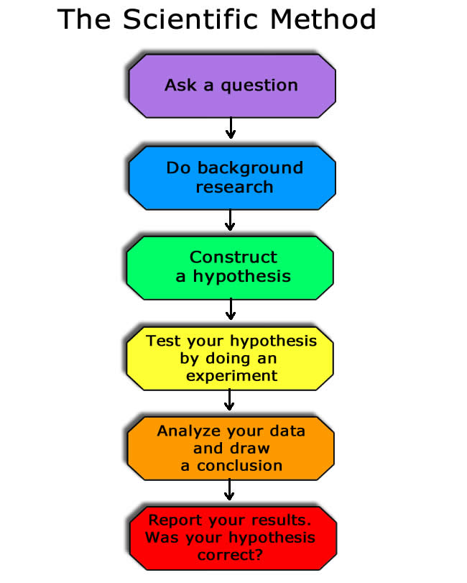
Scientific Method
NOT just this linear process

Slide 3
Scientific Method really looks like this:

Slide 4
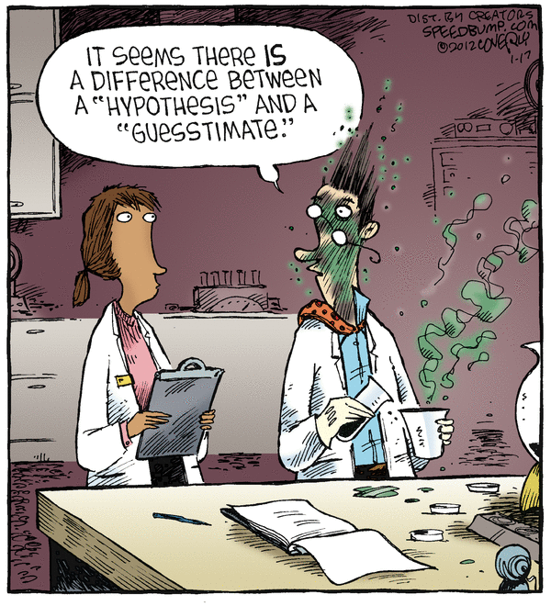
Hypothesis- an educated guess, based on observation
Prediction of cause and effect
Can be disproven, but not proven to be true (only supported)
“If… then..” Format

Slide 5
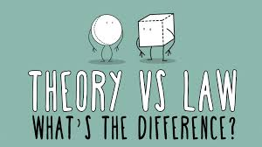
Scientific Theory- summarizes a hypothesis or group of hypotheses that have been supported with repeated testing
Valid as long as there is no evidence to dispute it (so can be disproven)

Slide 6
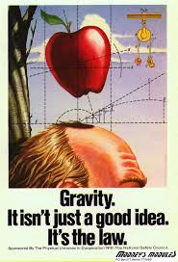
Scientific Law- a statement about an observed phenomenon or a unifying concept
generalizes a body of observations
explain things, but they do not describe them
Ex. Newton’s Law of Gravity
For more about the difference between scientific law and theory watch this video:
https://www.youtube.com/watch?v=GyN2RhbhiEU

Slide 7
Science is ALWAYS CHANGING!!!
New technology, etc.
There is no 'proof' or absolute 'truth' in science. The closest we get are facts, which are indisputable observations. Note, however, if you define proof as arriving at a logical conclusion, based on the evidence, then there is 'proof' in science.

Slide 8
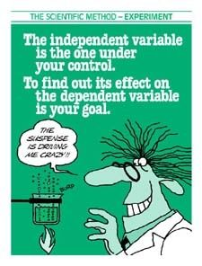

Slide 9
What does it mean to justify??
Justify:
verb jus·ti·fy \ˈjəs-tə-ˌfī\
Simple Definition of justify
: to provide or be a good reason for (something) : to prove or show (something) to be just, right, or reasonable

Slide 10
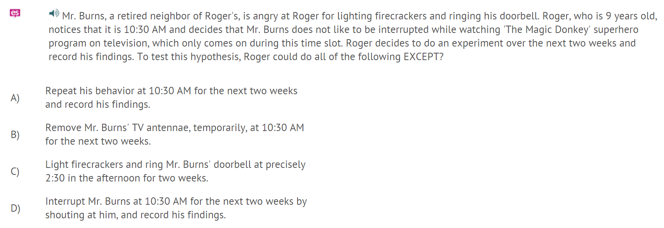
Exit Ticket:
Select an answer choice and JUSTIFY YOUR ANSWER
You will not receive credit if you do not justify your answer

Slide 11
A1 M&M Class Data!!!

Slide 12
A2 Period M&M Class data!!!

Slide 13
Combined Class Data (don’t have to include this on your lab… this is just for your reference)

