Slide 1
UNIT 2
MICROSCOPES AND
THE CELL THEORY
SB1.a. Explain the role of cell organelles for both prokaryotic and eukaryotic cells, including the cell membrane, in maintaining homeostasis and cell reproduction.

Slide 2
1.
Notes:
Velcro

Slide 3
2.
Notes:
Human tongue

Slide 4
3.
Notes:
Salt and pepper

Slide 5
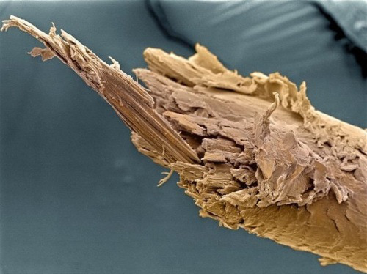
4.
Notes:
Split end of hair

Slide 6
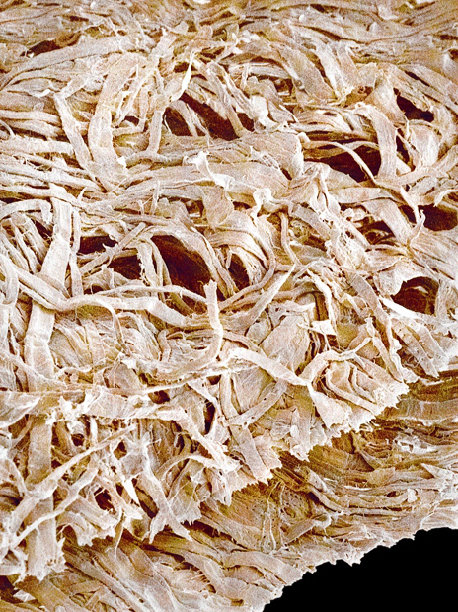
5.
Notes:
Toilet paper

Slide 7
6.
Notes:
Used dental floss

Slide 8
7.
Notes:
Rear ends of demodox (eyelash mites) on an eyelash hair

Slide 9
8.
Notes:
Sutured wound

Slide 10
9.
Notes:
Bone marrow making blood

Slide 11
10.
Notes:
Fat cells that have been emptied

Slide 12
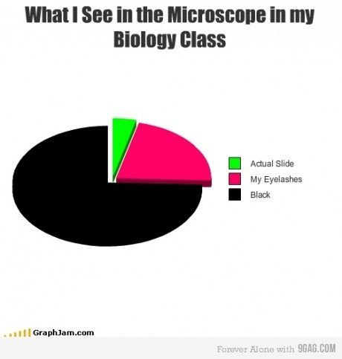
We are learning this so this doesn’t happen…

Slide 13
What are the properties of microscopes?
Used to see objects too small to see with naked eye.
Magnification- increase in apparent size of object
Total magnification-
Eyepiece lens (10x) multiplied by objective lens (4x, 10x, 40x, or 100x)
TWO TYPES:

Slide 14
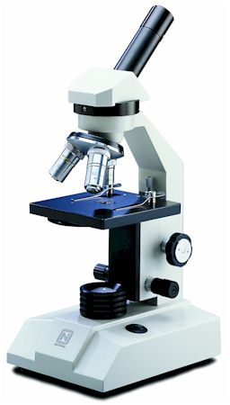
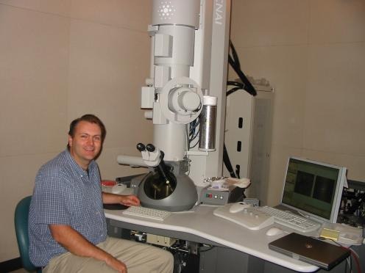
What are two types of microscopes?

Slide 15
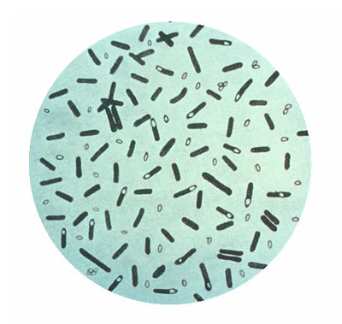
1. LIGHT MICROSCOPE (LM)
Magnifies objects using light.
Smallest item magnified would be a bacteria cell.

Slide 17
How does it work?

Slide 18
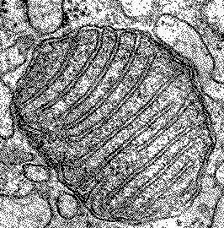
ELECTRON MICROSCOPES
Uses a beam of electrons.
Smallest item magnified would be cell organelles, macromolecules, viruses.
Must be in a vacuum so can’t view anything living.

Slide 19
OTHER THINGS TO KNOW:
How do you make a slide?
How do you find your object on the slide once made?
Microscope Reminders

Slide 20
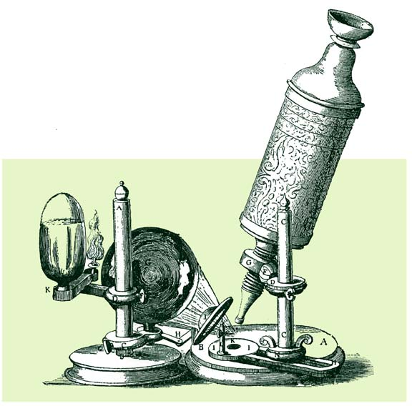
DEVELOPMENT OF THE CELL THEORY
Robert Hooke (1665)- discovered cells.
Thought they looked like monk’s bedrooms which were called “cells.”

Slide 21
DEVELOPMENT OF THE CELL THEORY
Schleiden (1839): botanist; all plant parts are made of cells
Schwann (1839): zoologist; all animal parts are made of cells
Both observed that there were different types of cells in each that performed different functions

Slide 22
DEVELOPMENT OF THE CELL THEORY
Rudolph Virchow (1855)
Stated all living cells come only from other living cells

Slide 23
The Cell Theory
All organisms are made up of cells
Cell is the basic unit of organization
Cells come from pre-existing cells

Slide 24
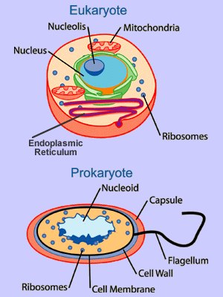
Eukaryote
Nucleus and organelles
Animals, plants, fungi, protists
Prokaryote
No nucleus or organelles
Bacteria

Slide 25
Unicellular- one celled (amoeba, bacteria)
Multicellular- many celled (animals, plants)

Slide 26
Activities for today:
Introduction to the Microscope Lab
Microscope Knowledge Check tomorrow

