Slide 1
Journal 3/22
What do you get when you cross an octopus and a chicken? And why? (use what you know about meiosis to explain)

Slide 2
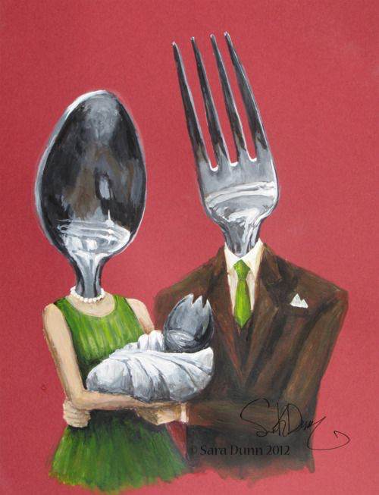
102 Biology
Meiosis
SB2. Students will analyze how biological traits are passed on to successive generations.
c. Using Mendel’s laws, explain the role of meiosis in reproductive variability.
e. Compare the advantages of sexual reproduction and asexual reproduction in different situations.
https://www.youtube.com/watch?v=qCLmR9-YY7o

Slide 3
TYPES OF CHROMOSOMES
Humans have 23 pairs of chromosomes (46 total)
Autosomes- first 22 pairs of chromosomes
Sex Chromosomes- last set of chromosomes that determine gender.
Females only carry X chromosomes in eggs
Males carry an X or Y in sperm.
If Egg with X meets sperm with X = XX = girl
If Egg with X meets sperm with Y = XY = boy

Slide 4
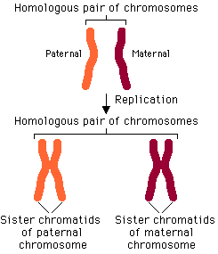
Homologous chromosomes
“Homo” = same
Two chromosomes that both carry genes controlling the same inherited trait.
One comes from father, one from mother
Have same banding pattern
Matching bands = matching traits

Slide 5
Have 2 alleles for each trait- one from mom & one from dad
Rule of Dominance- dominant trait usually masks another
Dominant trait = capital letter (this trait is expressed)
Recessive trait = lowercase letter (this trait is hidden)
EX: Brown eyes (B) dominant over blue (b)
Possible gene combinations could be
BB = brown eyes (homozygous dominant)
Bb = brown eyes (heterozygous)
bb = blue eyes (homozygous recessive)

Slide 6
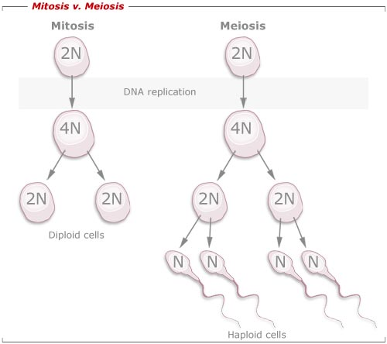
DIPLOID VS. HAPLOID
Diploid (2n) = FULL set of homologous chromosomes.
Human somatic cells = 46 chromosomes
Haploid (n) = 1 set of homologous chromosomes
Human gametes = 23 chromosomes
When sperm (23) meets egg (23) during fertilization it creates a zygote (46).

Slide 7
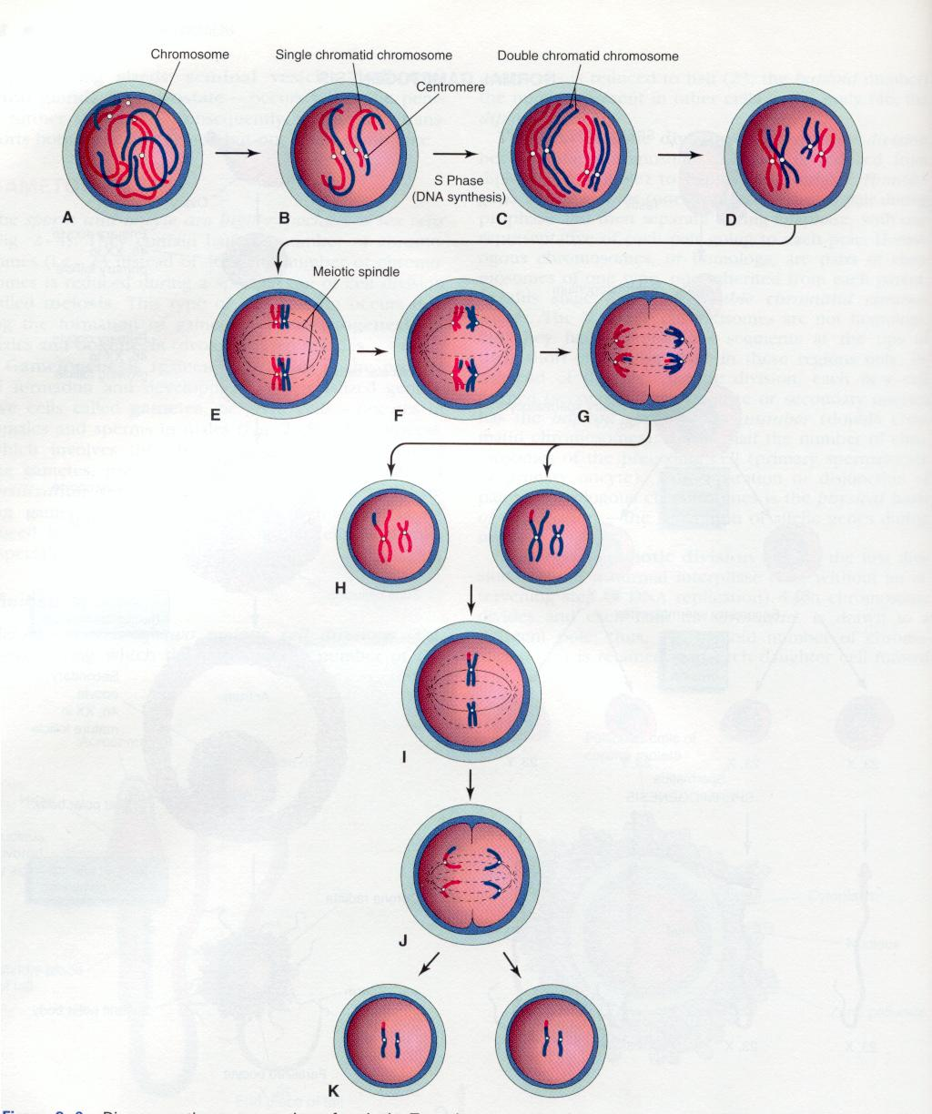
Describe meiosis
Produces haploid gametes.
Reduces the number of chromosomes in the cell so that when gametes combine they have the correct number of chromosomes.
2 major steps:
Meiosis I- homologous chromosomes separate
Meiosis II- sister chromatids separate (like mitosis)

Slide 8
MEIOSIS I
Interphase- DNA replicates
Prophase I-
Chromatin coils up
Homologous chromosomes pair up and form a tetrad (4 sister chromatids)
Nucleus and nucleolus disappear
Spindle forms and captures tetrad of chromosomes
Metaphase I-
Tetrad lines up at middle of cell
Anaphase I-
Tetrad splits. One chromosome goes to one pole, other goes to other pole
Telophase I-
Cell splits, nucleus and other parts reform.

Slide 9
MEIOSIS II
This is essentially the same as mitosis
The two cells from meiosis I go through these steps at the same time.
Prophase II
Spindle forms, chromosomes attach
Metaphase II
Chromosomes line up at the middle of cell
Anaphase II
Sister chromatids are pulled apart
Telophase II
Each cell splits into 2 more cells creating a total of 4 cells.

Slide 10
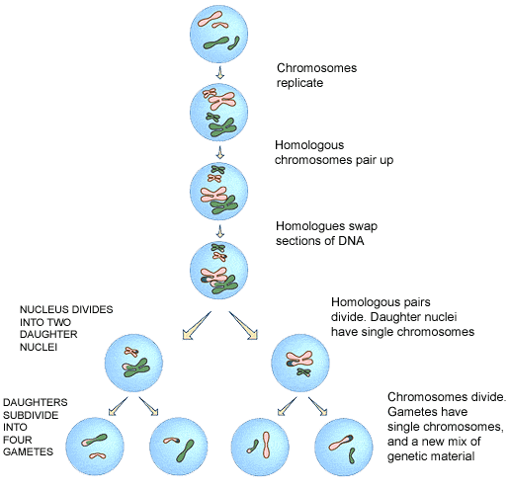

Slide 11
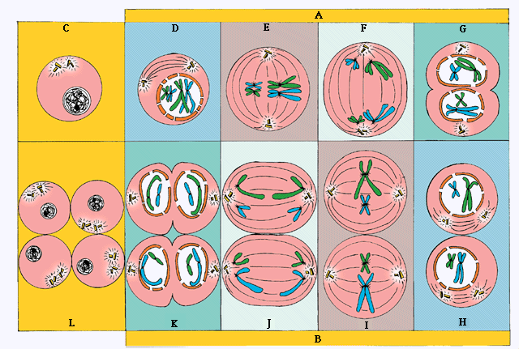

Slide 13
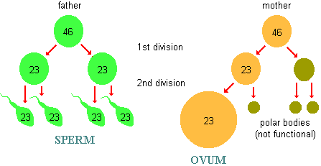
Difference in meiosis
In ovary of females:
Produces:
1 mature egg,
3 polar bodies which break down
Women born with all eggs they will have, meiosis I occurs before birth, meiosis II occurs once a month
Egg is much larger
Have all X chromosomes
Has no method of movement
In testes of males:
Produces: 4 mature sperm
Males begin to produce sperm after puberty, produced constantly until death; meiosis II occurs immediately after meiosis I
Much smaller than egg
May have X or Y chromosomes
Have flagella to move

Slide 14
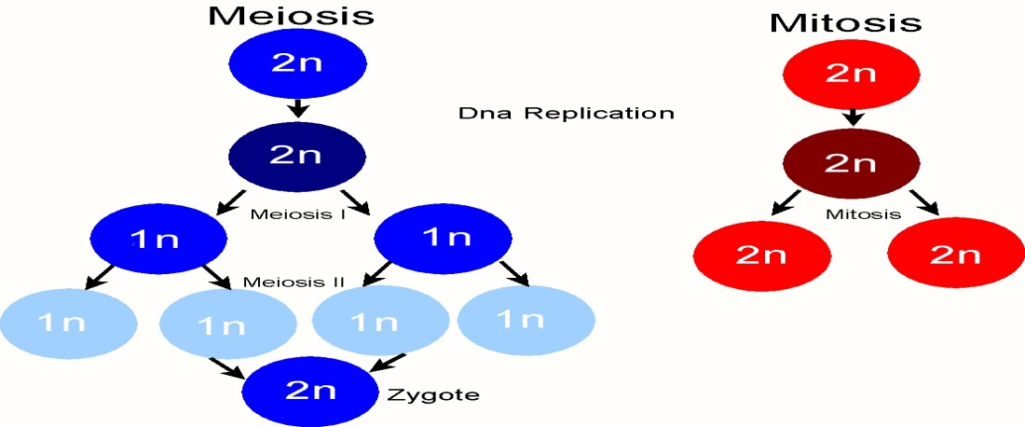
Mitosis/Meiosis
Mitosis
Cell division producing somatic cells
Results in 2 daughter cells
One division
Daughter cells have same number of chromosomes (2N) so are genetically identical to parent cell
Meiosis
Cell division producing gametes (sex cells)
Results in 4 daughter cells
Two divisions
Daughter cells have half the number of chromosomes (N) so are genetically varied from parent cell

Slide 15
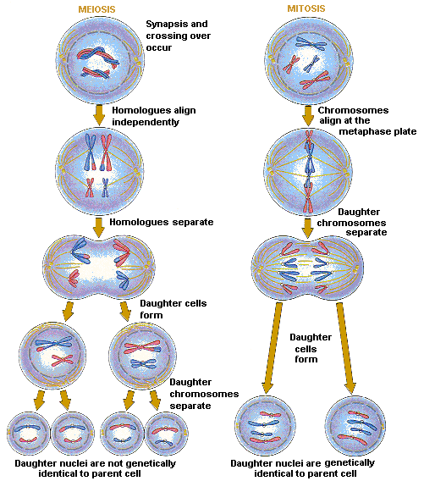

Slide 16
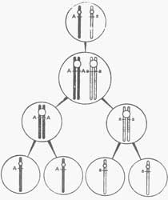
LAW OF SEGREGATION
All homologous chromosomes separate from each other and each gamete only gets one copy.
This is why it seems like some traits seem to disappear and then reappear in later generations.

Slide 17
LAW OF INDEPENDENT ASSORTMENT
Chromosomes can line up in any order before separating during metaphase I.
This leads to some gametes getting only mother genes and some only father genes.
This can also lead to some gametes getting mixture of mother and father’s genes.
This is how we get such large amounts of genetic diversity among the same species
See figure 10.11 p. 280

Slide 18
CROSSING OVER
Sometimes sister chromatids can exchange pieces of corresponding chromosome creating a new combination of traits.
Allows for genetic diversity
Figure 10.4 pg 272

