Slide 1
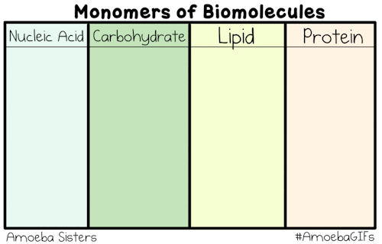
Organic Macromolecules

Slide 2
Today 1/25
Pick up food label handout and begin reading.
You don’t need your journal: Your warm-up is to have this handout completely read by the time we begin
Get out the food labels you collected and keep them on your desk

Slide 3
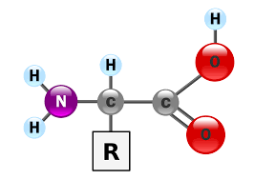
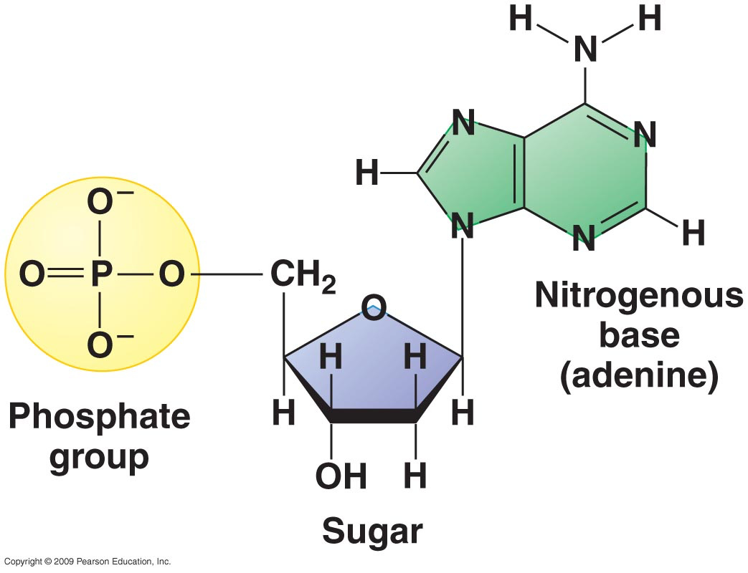
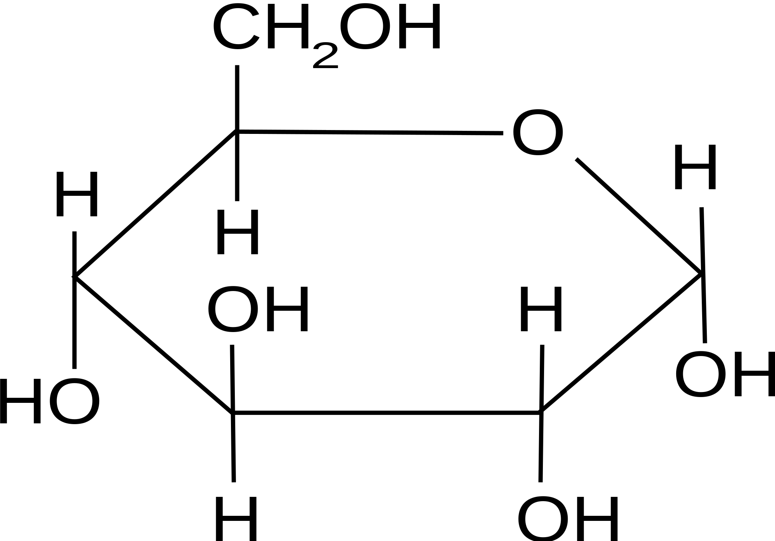
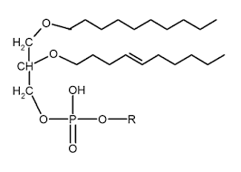
Today 1/27 in journal:
To review for quiz match each building block structure to the appropriate macromolecule (carbohydrate, lipid, protein, and nucleic acid):
1.
2.
3.
4.

Slide 4
Today 1/26 in your journal:
Use what we learned yesterday to answer the following:
Part 1: Which macromolecule would you test for with each of these indicators?
Part 2: For lunch you ate a big ol’ piece of steak and some potatoes. If you were to test the contents of your stomach right now you would find the results for which food #? (1, 2 or 3)
 | Iodine Solution | Glucose Test Strip | Biuret Solution | Brown Paper
Food Item #1 | Changed from amber to blue-black color | No color change in strip | Changed from blue to purple | No translucent spot formed
Food Item #2 | Remained amber | Strip changed from yellow to dark green | Remained blue | No translucent spot formed
Food item #3 | Remained amber | No color change in strip | Remained blue | Slight translucent spot

Slide 5
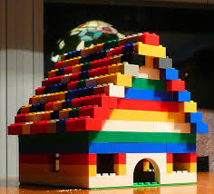
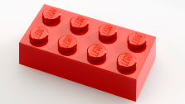
Organic macromolecules
WEIRD WORDS… BREAK THEM DOWN
Organic Macromolecules=
Monomer=
Polymer=
Notes:
Organic- contains carbon
Macro- big
Big things tend to be made of smaller parts
Mono- one
Monomer= one piece of larger puzzle (puzzle piece/ building block)
Poly= many monomers, big, lots of puzzle pieces
Polymer= macromolecule

Slide 6
4 main types of macromolecules:
Carbohydrate
Lipid
Nucleic Acid
Protein
Notes:
ALL big and ALL have carbon
ALL living things have a combination of these

Slide 7
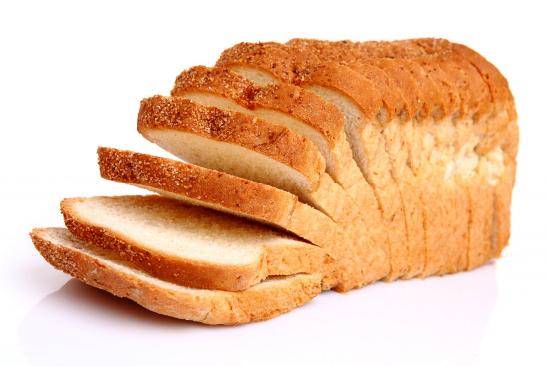
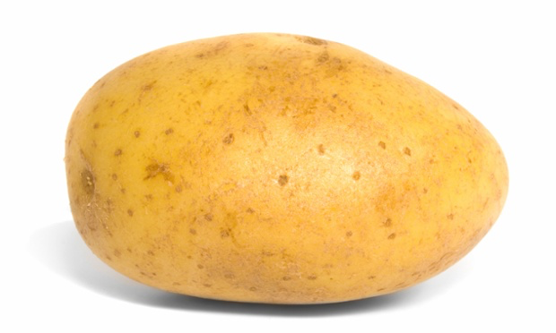
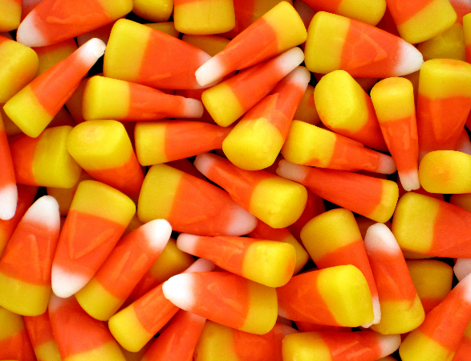
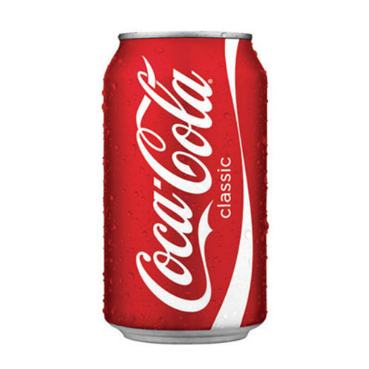
1. carbohydrates
Why are all of these things carbohydrates??
Notes:
All of these things are carbohydrates b/c have same monomer

Slide 8
carbohydrates
MONOMER
(Building block):
Monosaccharide
Memory clue:
Longest words go together!
(Carbohydrate= monosaccharide)
Notes:
(mono)=one
Saccharide= sugar
Candy house
One candy house= one ring

Slide 9
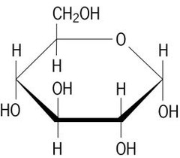
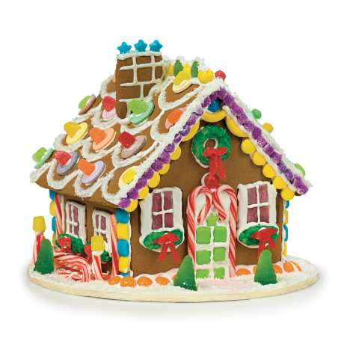
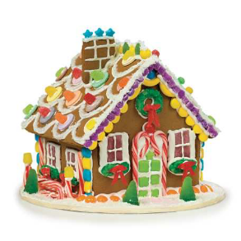
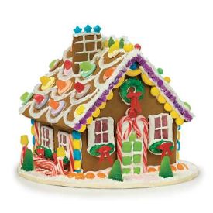
Carbohydrates
Structure:
Monosaccharide
(monomer)
Polysaccharide
(polymer)

Slide 10
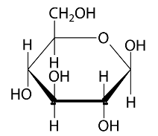
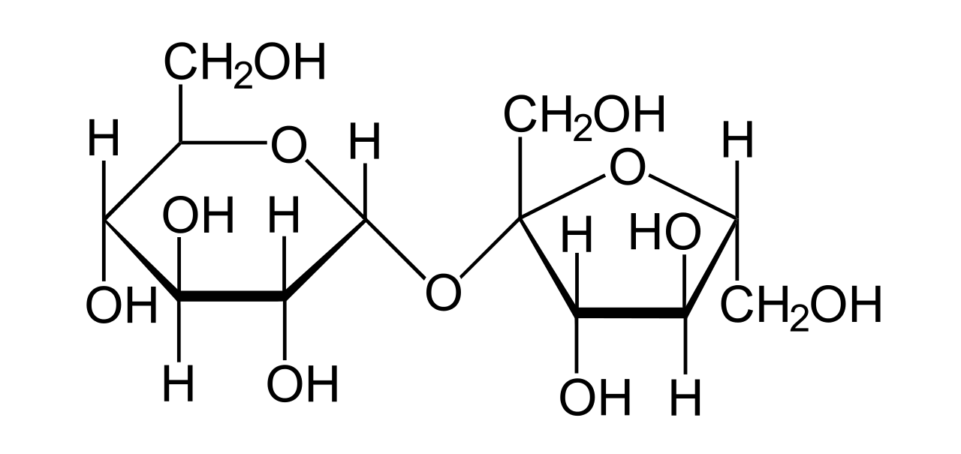
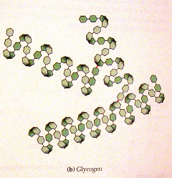
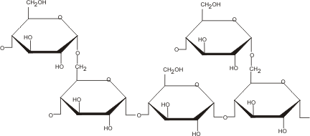
carbohydrates
Function (use): ENERGY SOURCE
Examples:
Glucose- Monosaccharide. Sugar! Energy!
Sucrose- Disaccharide, i.e. table sugar
Glycogen- Polysaccharide, in animals, stores energy (glucose) short-term in muscles
Polymer
Starch- Polysaccharide, basically same as glycogen but IN PLANTS, stores energy (glucose)
i.e. potato (just a big wad of sugar)
Cellulose- polysaccharide in plants as well, used for STRUCTURE in cell walls
*monomer
*polymer
*polymer
*polymer
*polymer

Slide 11
STOP and jot
What are the building blocks of carbohydrates?
When might you want to eat a lot of carbohydrates?

Slide 12
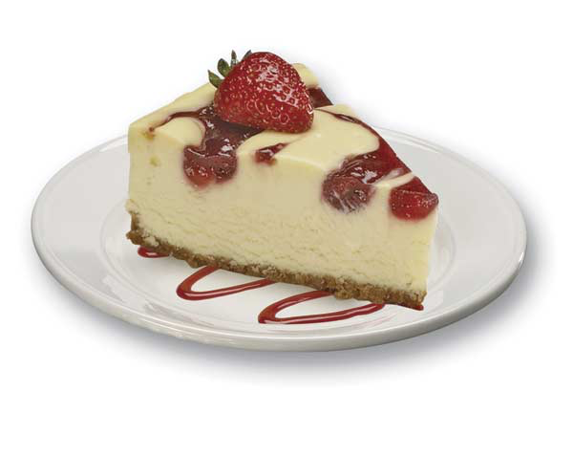
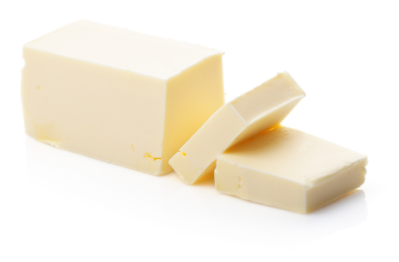
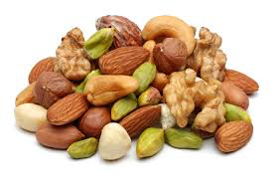
2. lipids
Why are all of these things lipids??

Slide 13
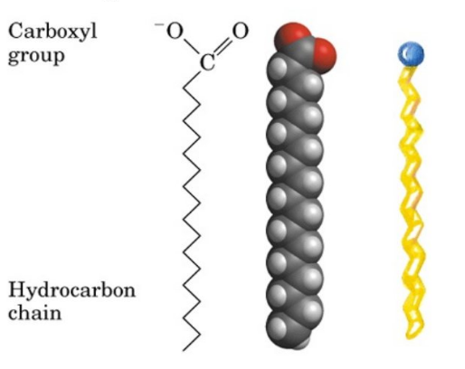
lipids
MONOMER
(Building block):
Fatty acid

Slide 14
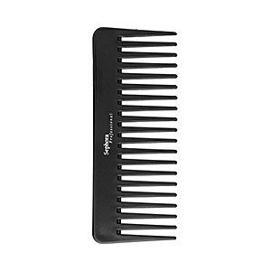
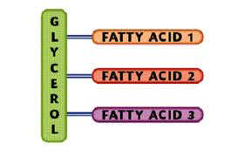
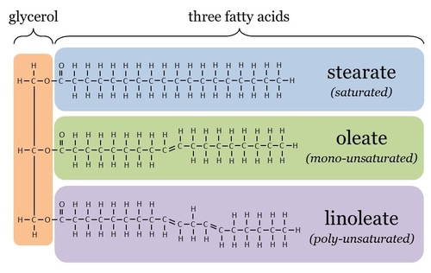
lipids
Structure
Notes:
Might use comb to comb oils through your hair!j
Reminder- carbs look like house, lipids look like comb

Slide 15
lipids
Function (use):
Energy Storage (long term)
Insulation- barrier that keeps heat in (or out)
Ex. Seals have thick layer of fat in cold polar waters so can maintain homeostasis
Examples
Fats- saturated and unsaturated
Oils- ALL (peanut, vegetable, olive, skin oils, etc.)
Waxes- beeswax, ear wax
Notes:
Energy storage- different than carbs b/c carbs are all short term energy storage, houses are all pretty bulky
Will convert bulky houses to combs (lipids) for long term energy storage- fat weighs less than sugar
Insulation- like in a house (keeping heat in)

Slide 16
Stop and jot
We use both carbohydrates and lipids for energy… what is the difference?
A bear is hibernating in the winter for a few months. Will it use carbs or lipids for energy?

Slide 17
3. proteins
Why are all of these things proteins??

Slide 18
proteins
MONOMER
(Building block):
Amino acid
Memory clue:
Pro-Amino

Slide 19
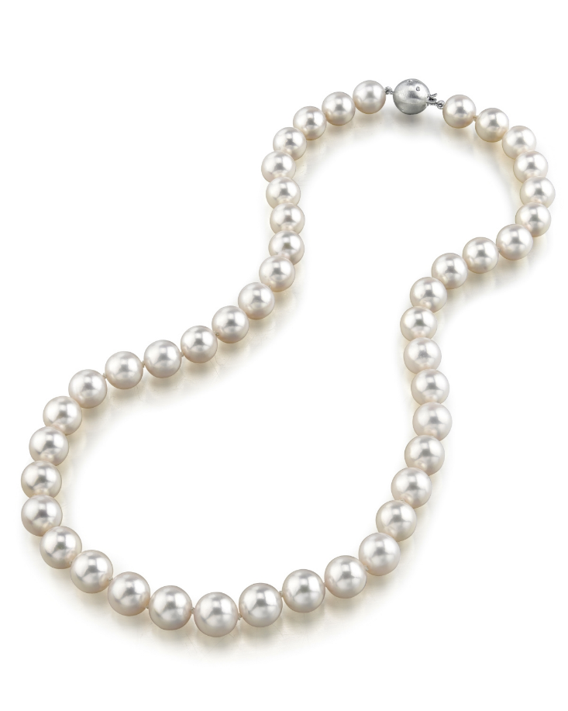
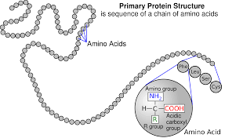
proteins
Structure:

Slide 20
proteins
Functions:
Structure- eye color, nose, skin, hair color, etc.. We are big piles of proteins
Speeds up Reactions- metabolism! So your body can keep up with you
Examples:
Keratin- (structure) hair, nails, skin
Enzymes- speed up chemical reactions!
Notes:
Quick science experiment- clean shower

Slide 21
Stop and jot
1. What is one thing that would happen to your body if you didn’t have enough protein?

Slide 22
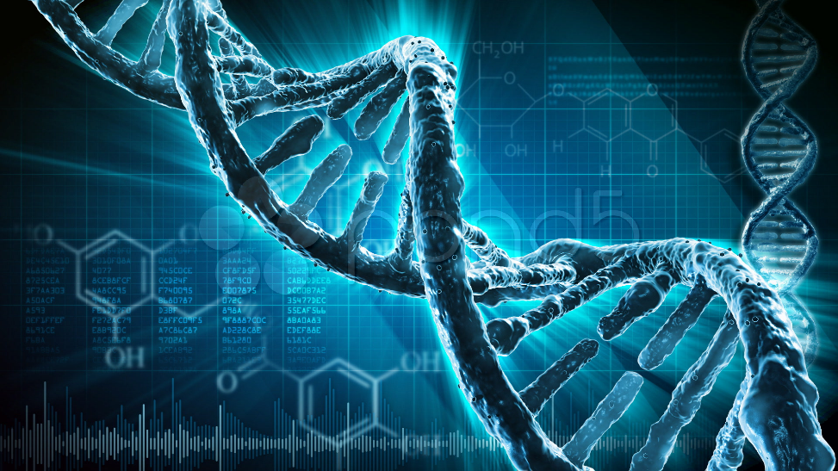
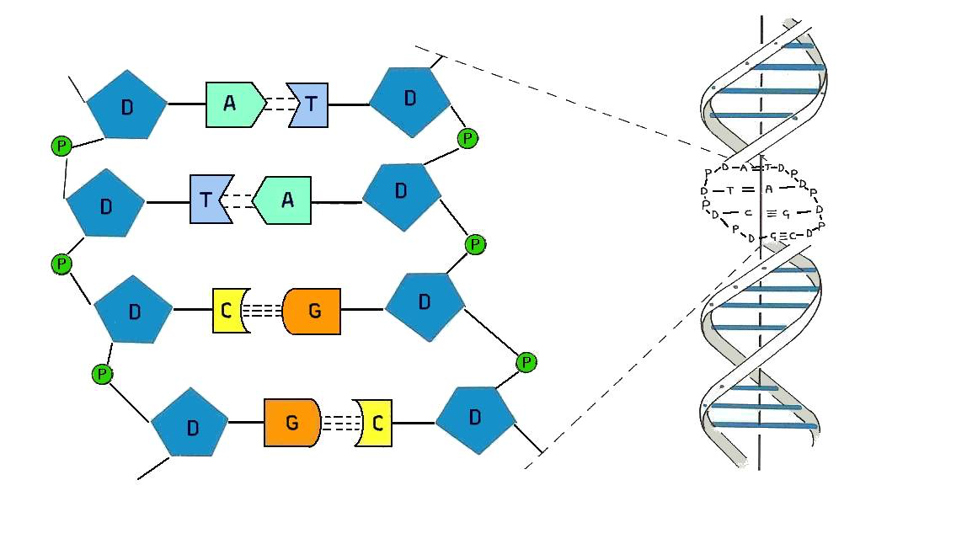
4. Nucleic acids
DNA

Slide 23
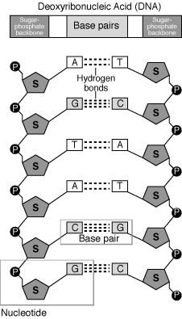
Nucleic acids
MONOMER
(Building block):
Nucleotide
Memory clue:
N with N
(Nucleic acid; Nucleotide)

Slide 24
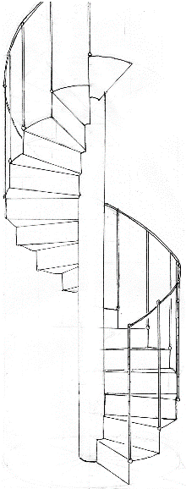
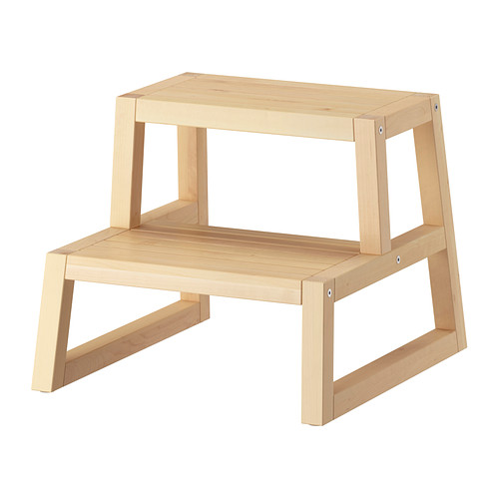
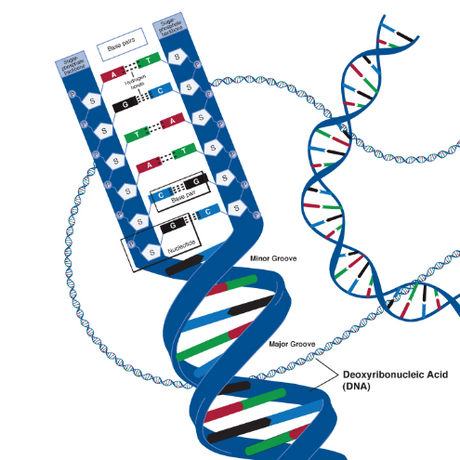
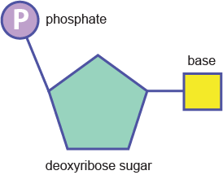
Nucleic acid
Structure:
Nucleic Acid (polymer)- DNA
Double helix is like a winding staircase
Nucleotide (monomer)-
Step
Notes:
“candy house”- another sugar!

Slide 25
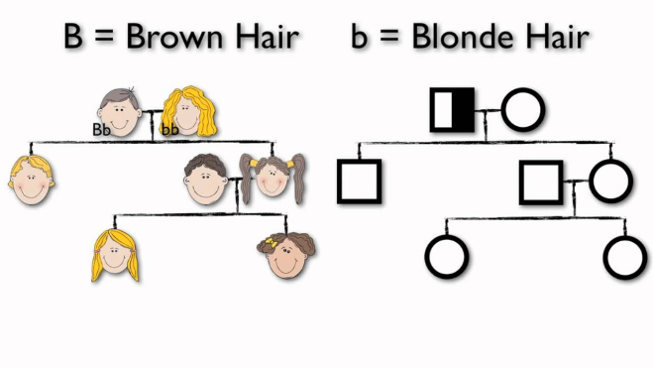
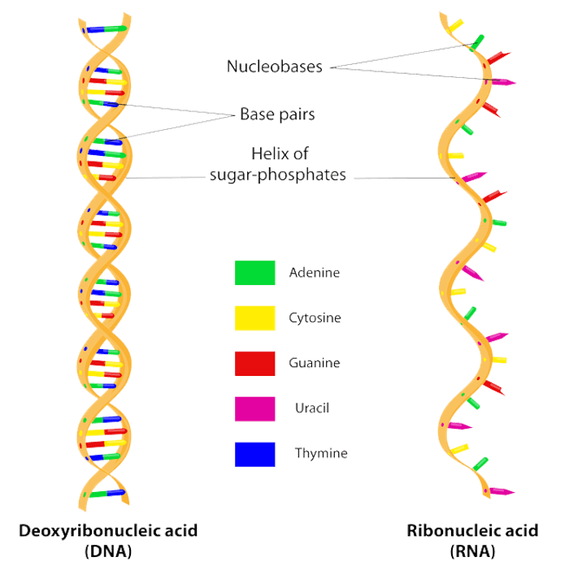
Nucleic acid
Function:
Heredity- passing of traits/genes from parents to offspring
Examples
DNA- deoxyribonucleic acid
RNA-ribonucleic acid
Notes:
Deoxyribo- sugar
Ribo-sugar
RNA- DNA’s skinny cousin

Slide 26
Quiz over all of this tomorrow morning!
Study these four different types of macromolecules and focus on their monomers, polymers, structure, and examples.

