Slide 1
Journal 3/1
Turn in your worksheet from yesterday
If haven’t already… tape your nucleotides to the class strand
Answer in your journal:
What (2) components remain the same throughout all 4 nucleotides?
Which component varies between all 4 nucleotides?

Slide 2
DNA Replication

Slide 3
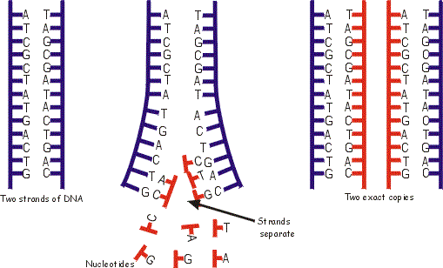
What is Replication?
Process by which DNA makes a copy of itself.
Copy needed for cell reproduction.

Slide 4
Structure of DNA:
Sugar Phosphate Backbone
Nitrogen bases
Antiparallel- one strand is 5’-3’ and the complementary strand is 3’-5’

Slide 5
Why is replication necessary?
So every new cell has an exact copy of original DNA strand.

Slide 6
But why do we need new cells?

Slide 7
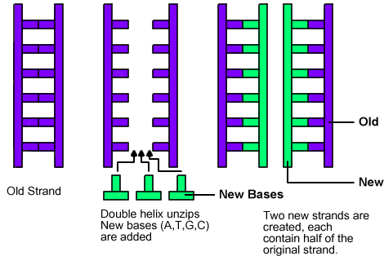
What are the steps of replication?
DNA untwists“unzip” into two separate strands.
Unzipped by helicase
Free nucleotides attach to complementary nucleotides to form 2 new strands of DNA.
Using DNA polymerase
Two complete strands will result (exact copies of each other)
Each resulting strands has one new half of DNA and one old half of DNA.

Slide 9
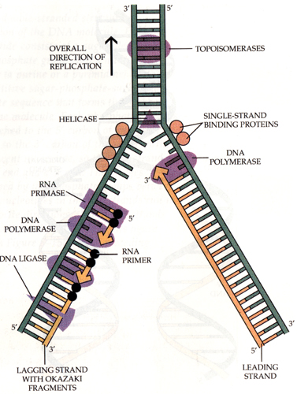
Leading strand- (on the right) is made continuously
Goes TOWARDS the fork
Lagging strand- (on the left) is made in fragments called Okazaki fragments
Goes AWAY from fork
Ligase “glues” fragments together

Slide 10
