Slide 1
Good morning!
Get out your Non-Mendel notes

Slide 3
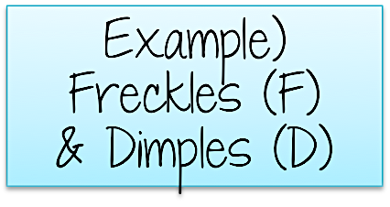
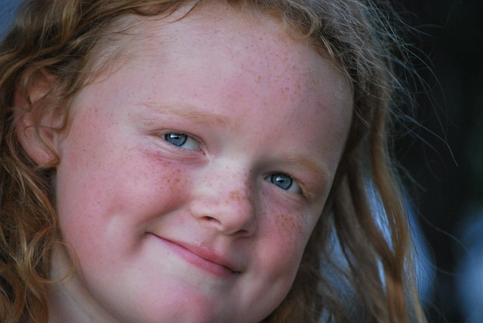
What is a dihybrid cross?
A dihybrid cross is a cross among two traits.
DI= TWO
HYBRID=
COMBINATION
Dihybrid Punnett squares are prediction tools used to determine probability for two traits.
Problem: Show the possible genetic combinations among offspring of a man who is heterozygous for both dimples and freckles, and a woman who is recessive for dimples and freckles.
♂ Ff Dd x ♀ ff dd

Slide 4
Setting up a dihybrid cross
When setting up your dihybrid cross, you first need to determine possible combinations among alleles for each gene when forming gametes.
Remember, you only inherit one allele per gene from each parent.
FfDd x ffdd
FD
Fd
fD
fd
fd
TIP: When determining allelic combinations among gametes, you can use the foil method for parental alleles.
Foil Method FfDd
(F f) (D d)
FIRST (of each letter)= FD
OUTSIDE= Fd
INSIDE= fD
LAST (of each letter)= fd

Slide 5
Setting a dihybrid cross
Which percentage of offspring can be predicted to have freckles (F) AND dimples (D)?
FfDd x ffdd
4 out of 16 or 25%
Which percentage of offspring can be predicted to have freckles (F) but NO dimples (d)?
fd fd fd fd
4 out of 16 or 25%
FD
Fd
fD
fd
FfDd
FfDd
FfDd
FfDd
Which percentage of offspring can be predicted to have dimples (D) but NO freckles (f)?
Ffdd
Ffdd
Ffdd
Ffdd
4 out of 16 or 25%
ffDd
ffDd
ffDd
ffDd
Which percentage of offspring can be predicted to have no freckles (f) nor dimples (d)?
ffdd
ffdd
ffdd
ffdd
4 out of 16 or 25%

Slide 6
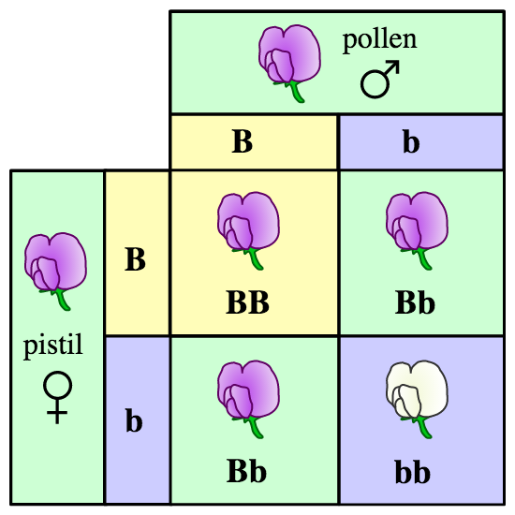
Patterns
Recall that specific statistics were seen in Mendelian genetics when crossing two heterozygous individuals in monohybrid crosses.
3:1 Dominant: Recessive
1: 2: 1 Homozygous Dominant: Heterozygous: Homozygous Recessive
Mendel repeated his experiment many times, and always obtained the same results in the F2 generation.

Slide 7
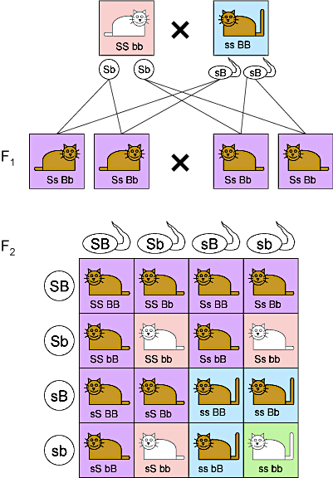
Patterns in Dihybrid Crosses
A similar pattern can be found when creating a dihybrid cross among two individuals who are heterozygous for both traits.
Example) Crossing two short-tailed brown cats that are both heterozygous for each trait.
Short tails are dominant (S); Brown fur is dominant (B)
9 Short-tailed Brown cats
3 Short-tailed white cats
3 long-tailed Brown cats
1 long-tailed white cats

Slide 8
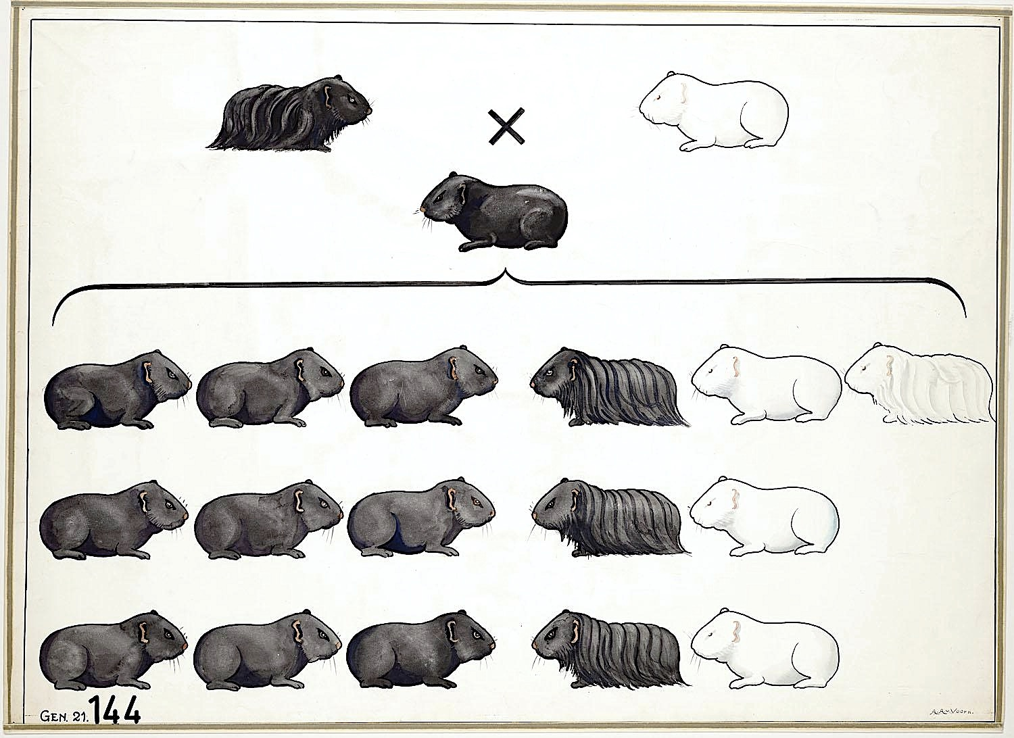
Try this…
Parental Cross= SsBb x SsBb
FIRST
OUTSIDE
INSIDE
LAST
Both Parents have the same genotype…
In guinea pigs, short hair (S) is dominant over long hair (s); and black fur (B) is dominant to white fur (b).
Cross two heterozygous individuals.
SB
Sb
sB
sb
SB
Sb
sB
sb

Slide 9
Homework:
Do part 3 of spongebob genetics problems (dihybrid crosses)
Complete your pedigree notes in BILL

