Slide 1
Do Now
You should have part 1 of “In & Out of the Cell” worksheet done (keep it on your desk)
Begin your next Do Now on page 32

Slide 2
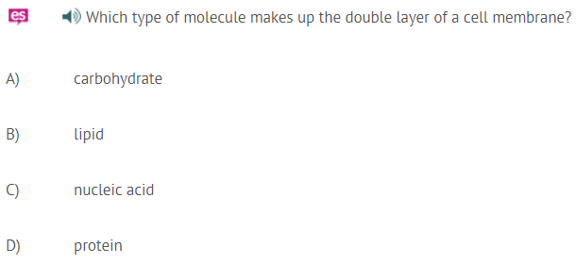

Slide 3
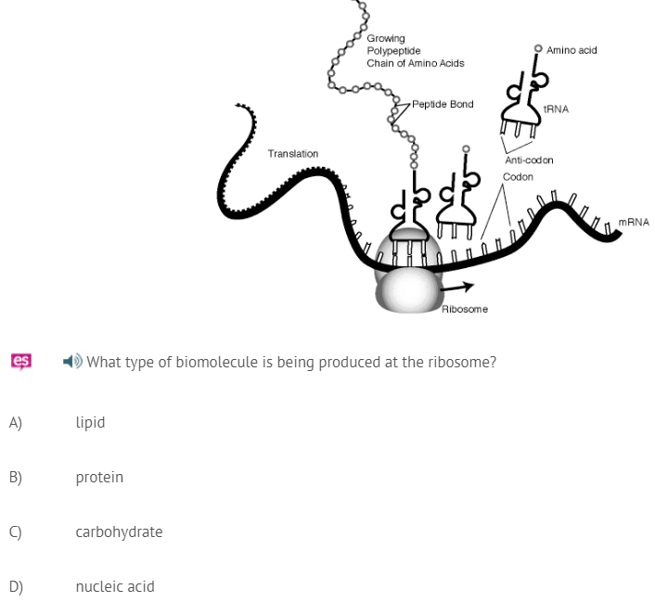

Slide 5
Do Now
Turn in your “In & Out of the Cell” webquest to the bin
Start your next Do Now on page 39 (today’s date is 10/23)

Slide 6
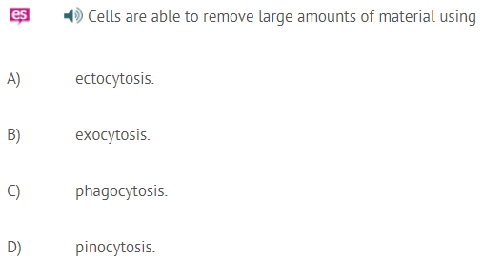

Slide 7
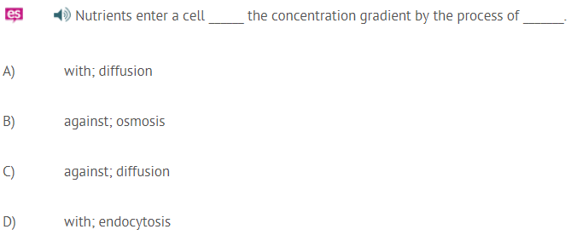

Slide 8
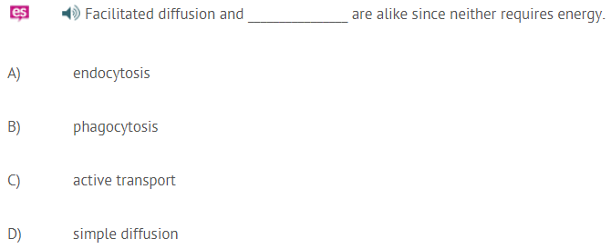

Slide 9
Cellular Transport Through the Cell Membrane
SB1.d. Explain the impact of water on life processes (i.e. osmosis, diffusion)

Slide 10
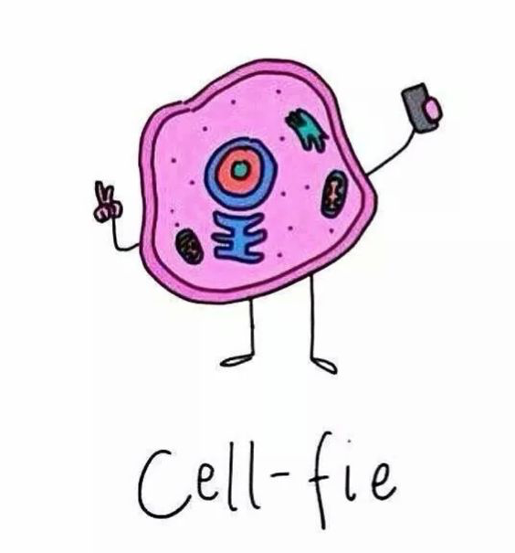
Today 1/8
Pick up journal and worksheet
Begin on worksheet (Answer #1-11 in journal)

Slide 11
How do your cells get the nutrients they need from the food you eat?
CHEW
EAT
DIGEST
FAT
SUGAR
PROTEIN

Slide 12
Nutrients Move Through Blood Vessels
FAT
BLOOD VESSEL
CELL
SUGAR
PROTEIN
SMALL INTESTINE

Slide 13
2 Types of Cellular Transport
Animations of Active Transport & Passive Transport
Weeee!!!
Passive Transport
- cell uses NO energy
- molecules move from an area
of HIGH to LOW concentrations
Diffusion
Facilitated Diffusion
Osmosis
Active Transport
- cell uses energy
- moving molecules from LOW
to HIGH concentrations
Protein Pumps
Endocytosis
Exocytosis
high
low
This is gonna be hard work!!
high
low

Slide 14
Passive Transport
cell uses no energy
Molecules move from an area of high concentration to an area of low concentration.
(High→Low)
Three types:

Slide 15
3 Types of Passive Transport
Diffusion- mvmt of any molecule from high to low
Facilitated Diffusion – diffusion with the help of transport proteins
Osmosis – diffusion of water only

Slide 16
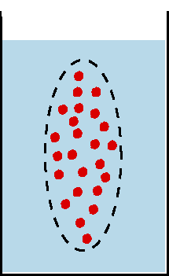
Passive Transport:
Simple Diffusion Animation
Diffusion: random movement of particles from high to low concentration
Goes with the concentration gradient
Its like going with the flow of a river.
High to Low
Continues until all molecules are evenly spaced & they’ve reached equilibrium
Note: molecules will still move around but stay spread out.
http://bio.winona.edu/berg/Free.htm

Slide 17
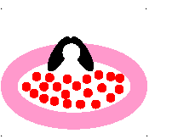
Passive Transport:
A
B
2. Facilitated diffusion: diffusion of specific particles through transport proteins found in the membrane
Transports larger or charged molecules
Facilitated diffusion (Channel Protein)
Diffusion (Lipid Bilayer)
Carrier Protein
http://bio.winona.edu/berg/Free.htm

Slide 18
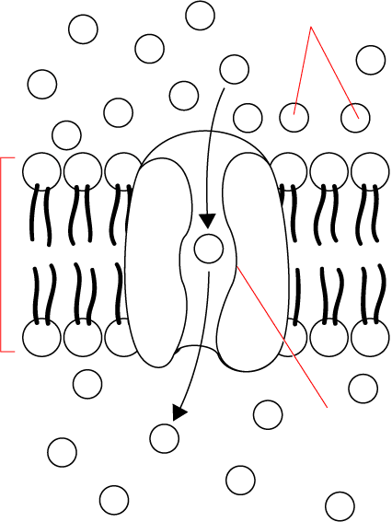
Passive Transport: 2. Facilitated Diffusion
Glucose
molecules
Cellular Transport From a-
High
High Concentration
Channel Proteins animations
Cell Membrane
Low Concentration
Protein
channel
Low
Transport Protein
Through a →
Go to Section:

Slide 19
Passive Transport:
Osmosis animation
3.Osmosis: diffusion of water through a selectively permeable membrane
Water moves from high to low concentrations
Water (smaller molecules) moves freely through pores.
Solute (green) too large to move across.

Slide 20
Active Transport
cell uses energy
actively moves molecules to where they are needed
Movement from an area of low concentration to an area of high concentration
(Low → High)
Three Types:

Slide 21
…..

Slide 22
3 Types of Active Transport
Protein Pumps- protein changes shape to move molecules against concentration gradient.
Endocytosis – cell changes shape to take in larger items.
Exocytosis – cell changes shape to release larger items.

Slide 23
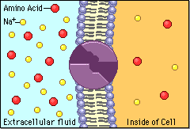
Types of Active Transport
Sodium Potassium Pumps (Active Transport using proteins)
1. Protein Pumps –use a transport protein that requires energy to do work
Protein must change shape to move molecules
This requires energy
Like going against the flow of a river- requires a lot more energy to swim upstream!
Protein changes shape to move molecules: this requires energy!

Slide 24
Sodium Potassium Pump:
Responsible for “action potentials” (what passes nerve signals along)

Slide 25
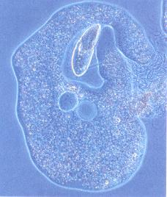
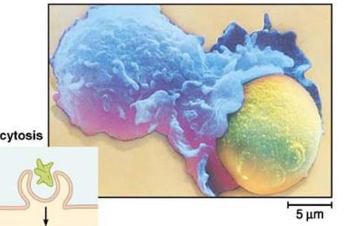
Types of Active Transport
2. Endocytosis: taking bulky material into a cell
Uses energy
Cell membrane in-folds around molecule
Phagocytosis- “cell eating”
Pinocytosis- “cell drinking”
forms food/liquid vacuole & fuses with lysosome for digestion
This is how white blood cells eat bacteria!

Slide 26
Types of Active Transport
3. Exocytosis: Forces large material out of cell in bulk
Vacuole fuses with the cell membrane
Cell changes shape – requires energy
EX: How hormones or wastes released from cell
Endocytosis & Exocytosis animations

Slide 27
Effect of botox:
Notes:
Disrupts exocytosis so acetylcholine can’t be passed to next neuron
Botulinum toxin injected in small doses (fatal if in large doses… harvested from a bacterium)

Slide 28
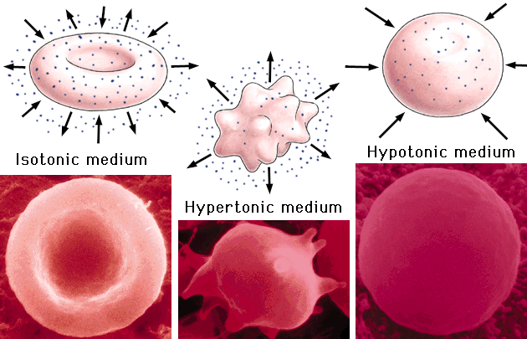
How does Osmosis affect Living Cells?
Water is so small that it can move through the cell membrane unaided. Thus the cell cannot always control the water’s movement.

Slide 29
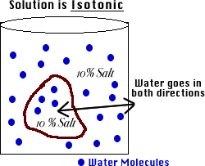
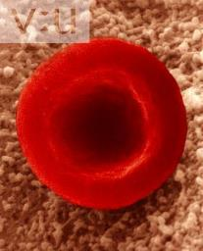
Isotonic Solution (Iso = equal)
Osmosis Animations for isotonic, hypertonic, and hypotonic solutions
Isotonic: The concentration of solutes in the solution is equal to the concentration of solutes inside the cell.
Result: Water moves equally in both directions and the cell remains same size! (Dynamic Equilibrium)

Slide 30
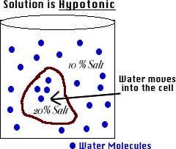
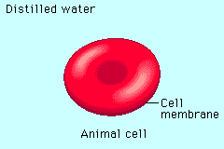
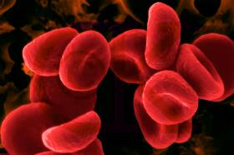
HypOtonic Solution (Hypo = below strength)
Osmosis Animations for isotonic, hypertonic, and hypotonic solutions
Hypotonic: The solution has a high concentration of water and lower concentration of solutes than inside the cell. (High water, low solute)
What concentration of water is in beaker?
90%: which is higher than in the cell so water goes in
Result: Water moves into the cell. Cell swells and bursts open (cytolysis)! (Cell swells like a big “O” just like the “O” in HypOtonic.)

Slide 31
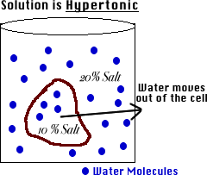
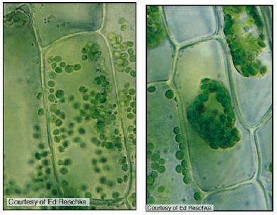
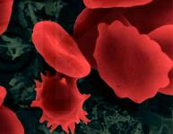
Hypertonic Solution (Hyper = above strength)
Osmosis Animations for isotonic, hypertonic, and hypotonic solutions
Hypertonic: The solution has a lower concentration of water and higher concentration of solutes than inside the cell. (Low water, high solute)
What concentration of water is in beaker?
80%: which is lower than in the cell so water goes out
shrinks
Result: Water moves out of the cell. Cell shrinks (Plasmolysis)! When water leaves plant cells, causes them to wilt.

Slide 32
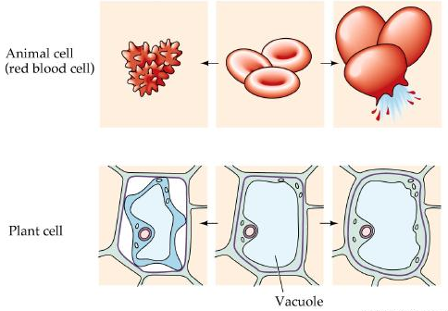
What type of solution are these cells in?
A
B
C
Hypertonic
Isotonic
Hypotonic

Slide 33
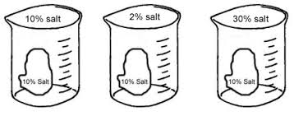
Let’s Practice!
Which way will the water move? Draw an arrow to show the direction
What will happen to the cell as a result?
Which type of solution is this? (hypertonic/ hypotonic/ isotonic)

