Slide 1
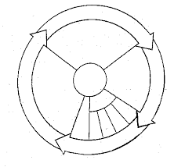
Today 3/17
Using the worksheet from yesterday, draw the cell cycle and label the different stages!

Slide 4
Today 3/15
Answer the following writing prompt IN COMPLETE SENTENCES in your journal:
What do you think: What does it mean to die of “natural causes” or to die of “old age?” And why does this happen?

Slide 5
 | Normal Cells w/ 20% Oxygen | Normal cells w/ 3% Oxygen (equal to internal environment of humans) | Cancer Cells
Average number of cell doublings | 50 | 70 | No Limit
What does the data say?
What conclusion can you assume or draw from this data?
Write a question about these findings. What more do you want to know? Or what else might you consider testing?

Slide 6
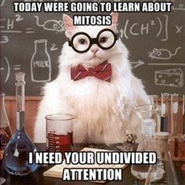
Cell Division

Slide 7
Today 1/9
Turn in your H.W. to the bin
As your first “Do Now” of the semester on page 57 answer the following in your notebook in complete sentences: What is the difference between normal cells and cancerous cells?

Slide 8
Asexual vs. Sexual Reproduction

Slide 9
CELL REPRODUCTION
Sexual Reproduction
Sperm and egg are produced & fused
Newly produced cells are genetically different from each other and the parent cell.
This creates genetic diversity
If it occurs in
human body cells- called meiosis
Single-celled organisms like bacteria or protists- called conjugation.
Asexual Reproduction
No sperm or egg are used
Newly produced cells are genetically identical to parent cell- clones
If it occurs in…
human body cells (like the skin)- called mitosis
single-celled organisms like bacteria or protists- called binary fission
simple animals (like sponge)- called budding

Slide 10
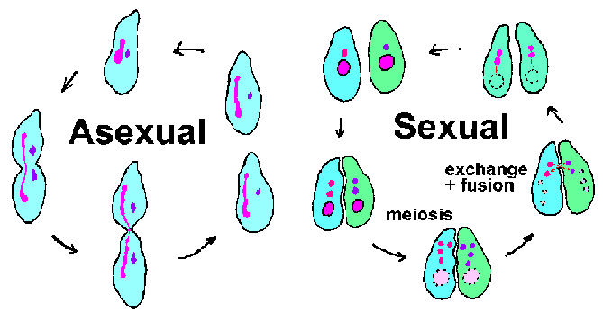

Slide 11
Remember: DNA REPLICATION
*Before cell can reproduce- the DNA must replicate.

Slide 12
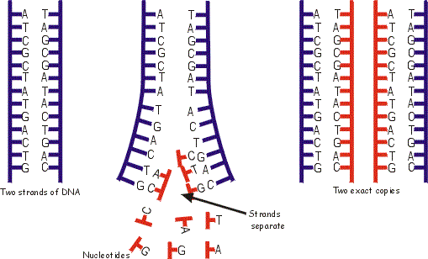
What is Replication?
Process by which DNA makes a copy of itself.
Copy needed for cell reproduction.

Slide 13
Structure of DNA:
Sugar Phosphate Backbone
Nitrogen bases
Antiparallel- one strand is 5’-3’ and the complementary strand is 3’-5’

Slide 14
Why is replication necessary?
So every new cell has an exact copy of original DNA strand.

Slide 15
But why do we need new cells?

Slide 16
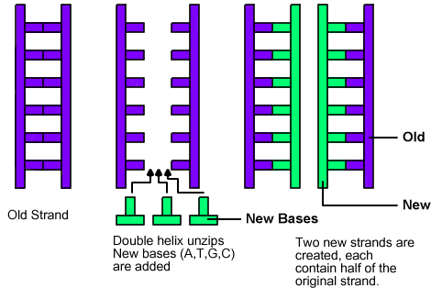
What are the steps of replication?
DNA untwists“unzip” into two separate strands.
Unzipped by helicase
Free nucleotides attach to complementary nucleotides to form 2 new strands of DNA.
Using DNA polymerase
Two complete strands will result (exact copies of each other)
Each resulting strands has one new half of DNA and one old half of DNA.

Slide 17
CHROMOSOMES
After DNA replicates it becomes chromosomes…

Slide 18
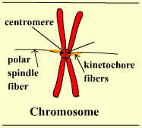
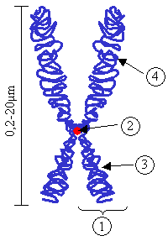
What are chromosomes?
Carriers of genetic material found in nucleus
Basically it is coiled up DNA
Chromosomes contain thousands of GENES which code for thousands of PROTEINS and are made up of millions of NITROGEN BASE PAIRS.

Slide 19
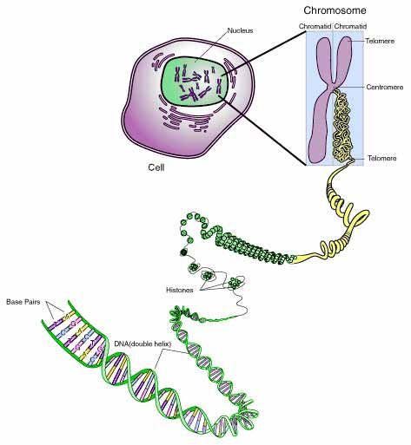
What are the components of a chromosome?
Chromatin- long, thin strands of DNA
Chromosome - coiled up strands of chromatin. Forms an “X” like structure
2 Sister Chromatids- each piece of a chromosome
Centromere- spot that holds each sister chromatid together.

Slide 20
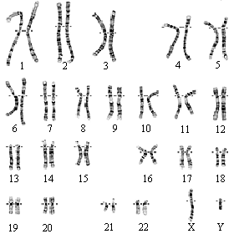
How many chromosomes are in human cells?
46 in somatic (body) cells- like skin, muscle.
23 in gametes (sex cells- like sperm & egg).

Slide 21
Background
Human embryos are similar in size to a rat embryo. Why then do they end up being such different sized organisms? The size of an organism is determined mostly by its number of cells and partially by the sizes of those cells. Certain cells in a human might be smaller than certain cells in a mouse and vice versa. In addition, most cells have a limit to the size they can grow. On the other hand fat cells can grow larger when we store excess calories as fat droplets inside those cells. The more droplets, the larger the cell becomes until it reaches a point in which the control center (nucleus) can no longer manage a cell of that size. At that point the cell must undergo cell division.

Slide 22
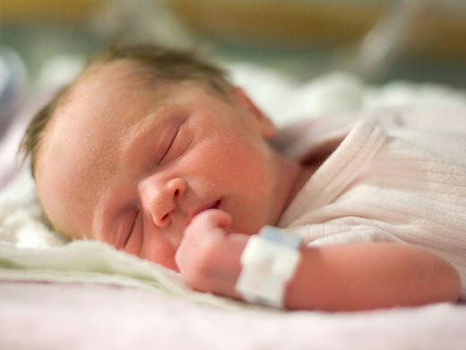

Slide 23
Directions:
In order for cells to divide, it needs to make copies of the genetic code, cell organelles and other molecules necessary for each of the daughter cells to survive. After this point, the cell is ready to divide. The process of cell division occurs in a series of observable steps that scientists have termed “mitosis”.
Through observation of the following stages of mitosis, figure out the most logical sequence of events.
You know you are starting with one cell and ending with two.

Slide 24
THE CELL CYCLE
After DNA replicates and is formed into chromosomes, the cell can go through the process of dividing.

Slide 25
What is the cell cycle?
Sequence of growth and division in the cell

Slide 27
Mitosis
Process by which cells divide to produce TWO IDENTICAL DAUGHTER CELLS

Slide 28
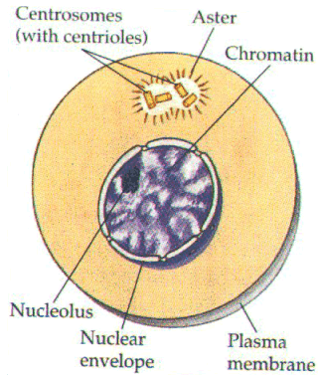
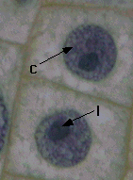
INTERPHASE
Nucleus is intact.
Nucleolus is present.
Chromatin is loosely contained in nucleus.
Chromatin replicates.
Longest phase of the cell cycle

Slide 29
PROPHASE
Longest phase of mitosis
Chromatin coils into chromosomes
The nucleus & nucleolus disappear
Centrioles form and move to opposite poles of cell
Spindle fibers form from centrioles and begin to cross cell

Slide 30
METAPHASE
Chromosomes line up in the middle of the cell
Spindle now forms across the cell
Meta = “middle”

Slide 31
ANAPHASE
Spindle fibers begin to shorten/break down
This pulls chromosomes apart
Now the chromosome halves are referred to as chromatids
Ana = “away”

Slide 32
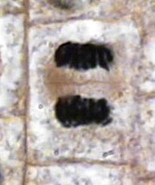
TELOPHASE
Chromatids reach poles
Chromosomes unwind into chromatin
Spindle fibers break down
Nucleolus and nuclei reform
Plasma membrane begins to cleave (pinch in)

Slide 33
What is Cytokinesis? Division of cytoplasm
How is cytokinesis different in plants and animals?
animal cells: cell membrane cleaves until two daughter cells are formed
plant cells: cell plate forms in center of cell and splits cells

Slide 34
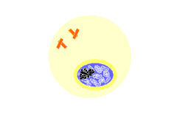
I- INTERPHASE
P- PROPHASE
M- METAPHASE
A- ANAPHASE
T- TELOPHASE
I-P-M-A-T

Slide 35
https://vimeo.com/8333643

Slide 36
QUIZ: THE CELL CYCLE NAME ________________
The process of DNA replication is necessary before a cell ___.
Makes a protein
Codes for RNA molecules
Divides into 2 cells
Mitosis generates ___.
Daughter cells that are genetically identical to the mother cell
Proteins from amino acids
Daughter cells that are genetically different from the mother cell
If a cell did not complete interphase, ___.
The cell would die
DNA would not replicate
The nuclear membrane would break up
If a skin cell of a dog has 20 chromosomes. How many would be in each new daughter skin cell created by mitosis?
a. 40
b. 10
c. 20

Slide 37
Which series of steps shows the correct sequence of mitosis?
1, 2, 3, 4
2, 1, 3, 4
4, 3, 1, 2
3, 4, 1, 2
What stage of the cell cycle is shown below?
Prophase
Metaphase
Telophase
What is letter X pointing at?
Chromatin
Chromatid
Chromosome
What is letter Y pointing at?
Centrioles
Spindle fibers
Chromosomes
1
2
3
4
Y
X

